Slide 1
Branches and Jumps
By Christopher Mar

Slide 2
Example Situation
Assume $a0 already contains some value
If register $a0 contains a 1
Set $v0 to 2
If register $a0 contains any other value
Set $v0 to 4

Slide 3
Example Pseudo Code
if($a0 == 1) // if condition check
{
$v0 = 2; // if block
}
else // else condition
{
$v0 = 4; // else block
}

Slide 4
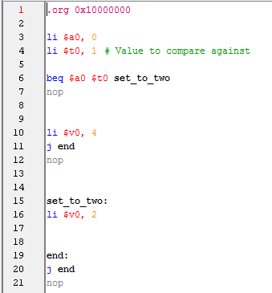
Solution Breakdown
If condition check
Else block
If block

Slide 5
Control Flow Visualization
Assume:
$a0 is 0
$t0 is 1
Expected Result
$v0 set to 4

Slide 6
Control Flow Visualization
Assume:
$a0 is 1
$t0 is 1
Expected Result
$v0 set to 2

Slide 7
Demo of Code

